Slide 1
SUST Medical Center Management System
Given Task : Requirements analysis
Team Member :
Rifat Shariar Sakil - 2019831024
Samiul Islam Mugdha - 2019831048
Shahriar Alvi - 2019831033
Horipriya Das Arpita - 2019831068

Slide 2
Introduction:
The Health Service Centre, SUST located near the central auditorium just opposite to the basket ball ground , offers free experienced general practitioner and emergency medical care services to all members of the University community: students (undergraduate and post graduate), teachers, staffs and their families in a user-friendly efficient environment. Students get medicine from the Centre at free of cost but they need to show their Medical card at all consultations and employees get medicine at minimum cost. The Centre provides service round the clock, seven days a week. The center also has an ambulance.

Slide 3
SUST MEDICAL CENTER MANAGEMENT SYSTEM
The purpose of this project is to digitalize the clinic management system and ensure a consistent quality service to the patients.
SUST Medical Center Management was introduced to solve the complications coming from managing all the paper works of every patient associated with the various departments of hospitalization with confidentiality.
Purpose
A multispecialty medical center sees numerous patients entering and exiting each day, making it challenging to maintain their records securely. To alleviate this burden and efficiently manage the center's financial, administrative, and clinical aspects, a Medical Center Management system was developed.

Slide 4
Services provided at the University Health Service Centre include:
Routine medical examinations & health checkups (blood pressure, RBS by glucometer etc.)
Treatment of illness, injury, & other physical problems
Minor Surgical Procedures (drainage of abscess, boil etc.)
Minor Wound Management
Sports Injury Management
Travel Medicine and Advice
Advice & assistance for students with examination difficulties
Special arrangements for students with disabilities and sick students
Referral to specialists ,imaging services, pathology, and physiotherapy according to need and condition of the patient
Organize blood grouping and donation campaign under direct supervision
Vaccination :Hepatitis B and Ca cervix
Issuing medical card for the students and give medical clearance after completion of their respective courses(BSC, MSC)
Medical Assessments/Pre-Employment Medicals :By issuing fitness certificate

Slide 5
Manage all the paperwork in one place and reduce the human resources costs as most of the work is automated.
Maintain the medical records of the patient, the contact details of the patient.
This System provides
Manage appointment and keep track of the appointment dates.
Save the insurance information for later reference,
tracking the bill payments.

Slide 6
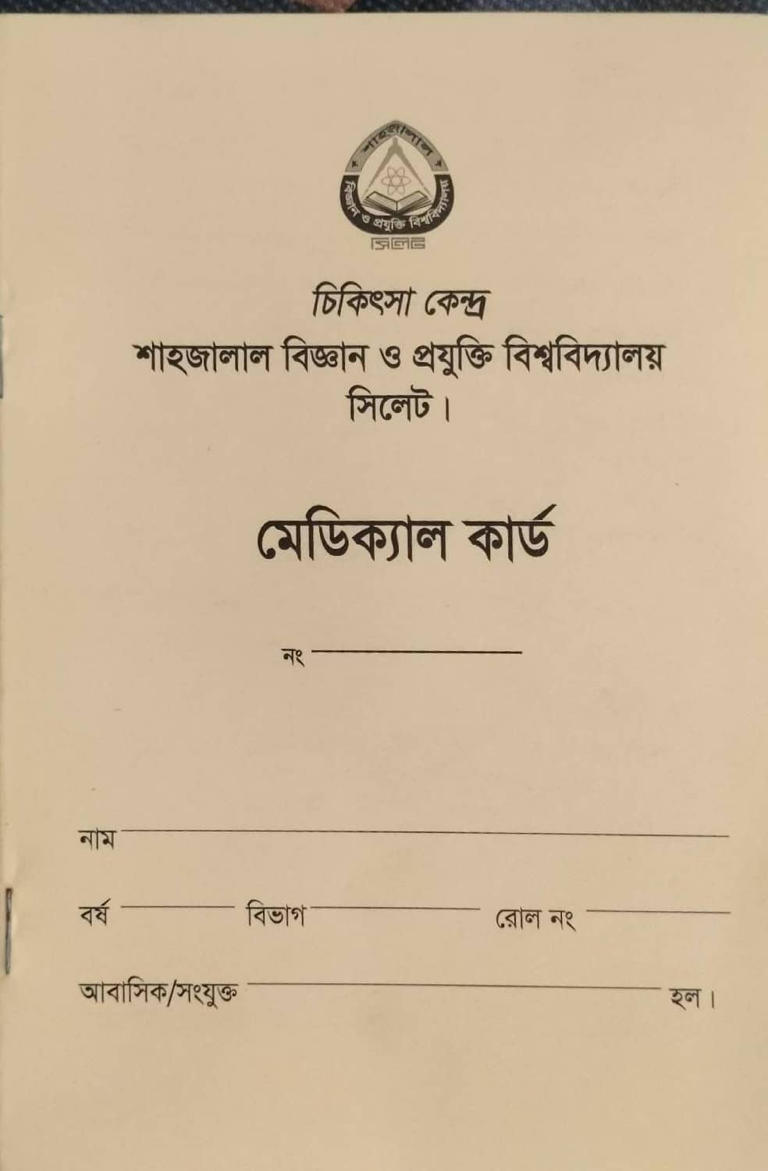
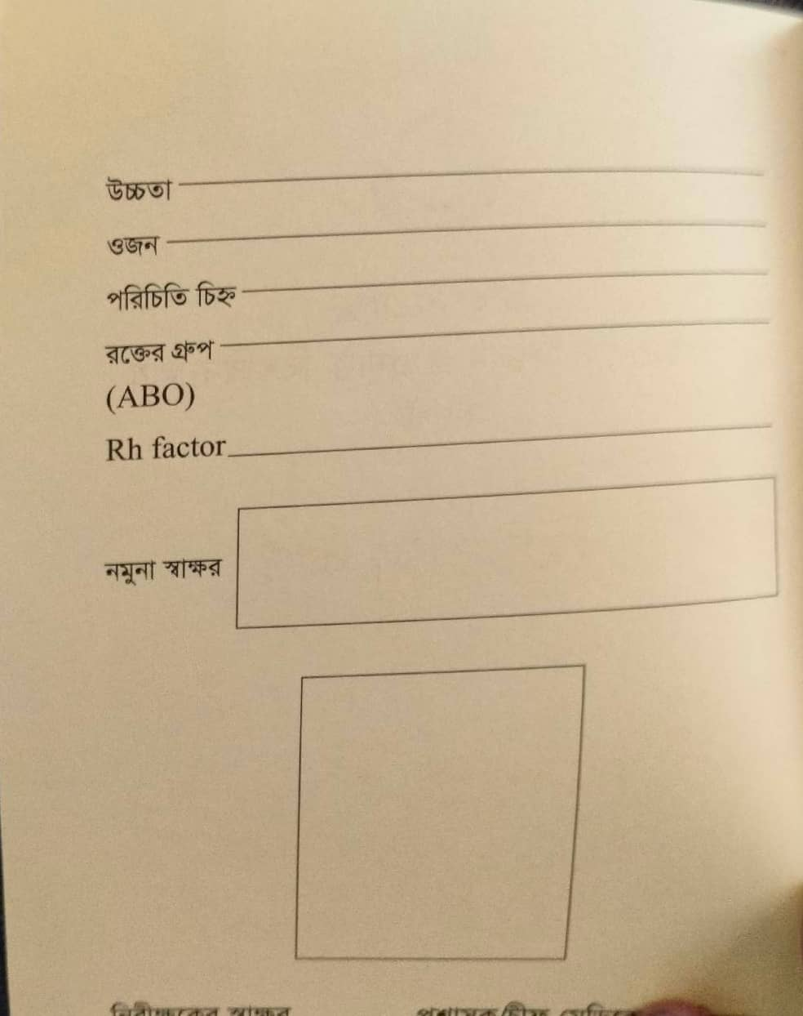
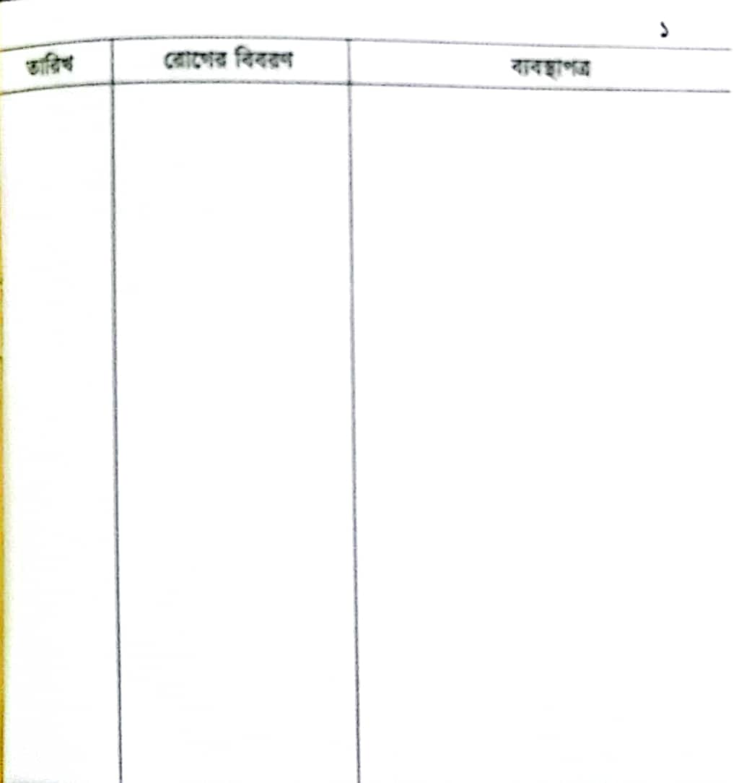
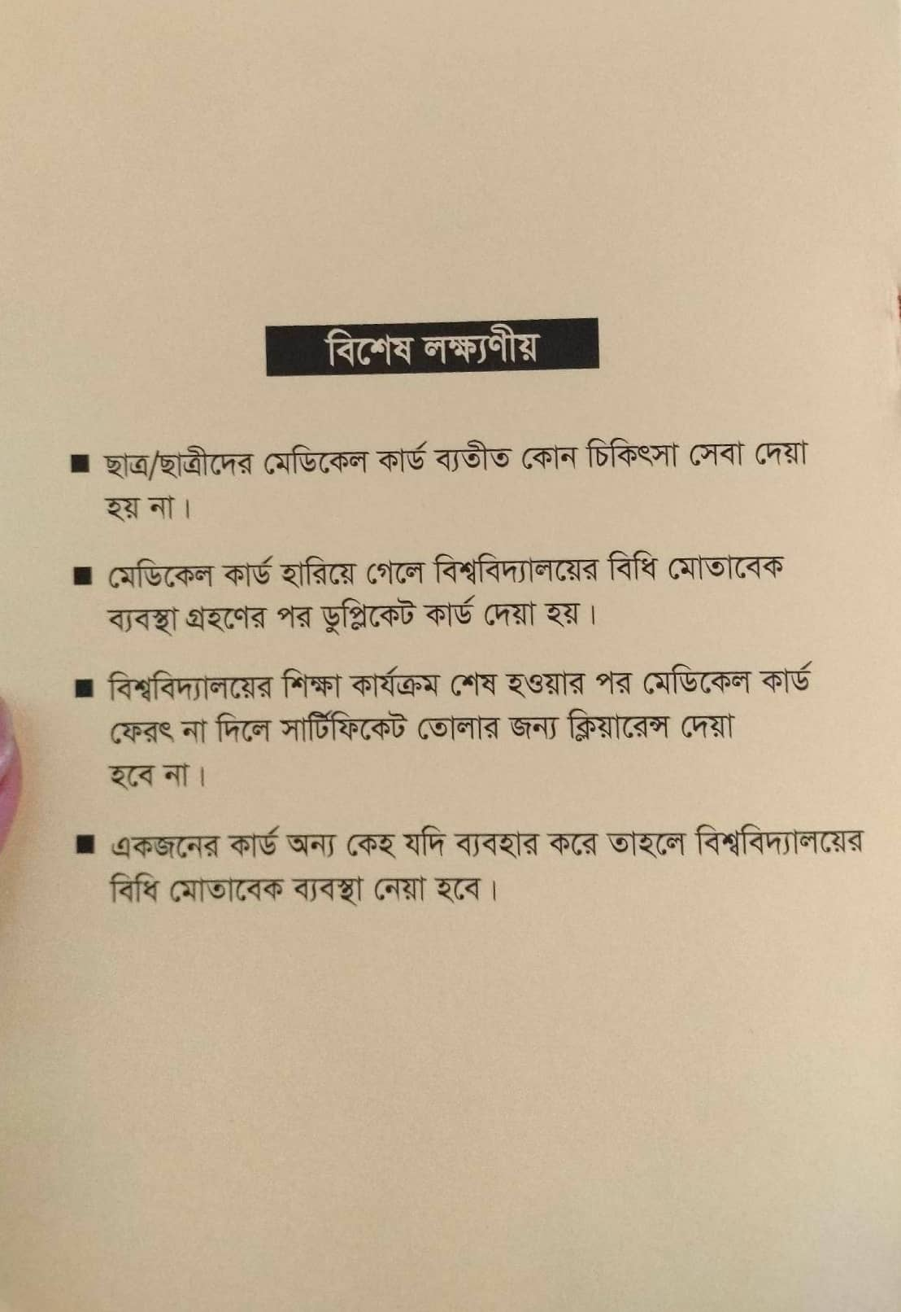
Here is some raw data that we collected from SUST Medical Center:

Slide 7
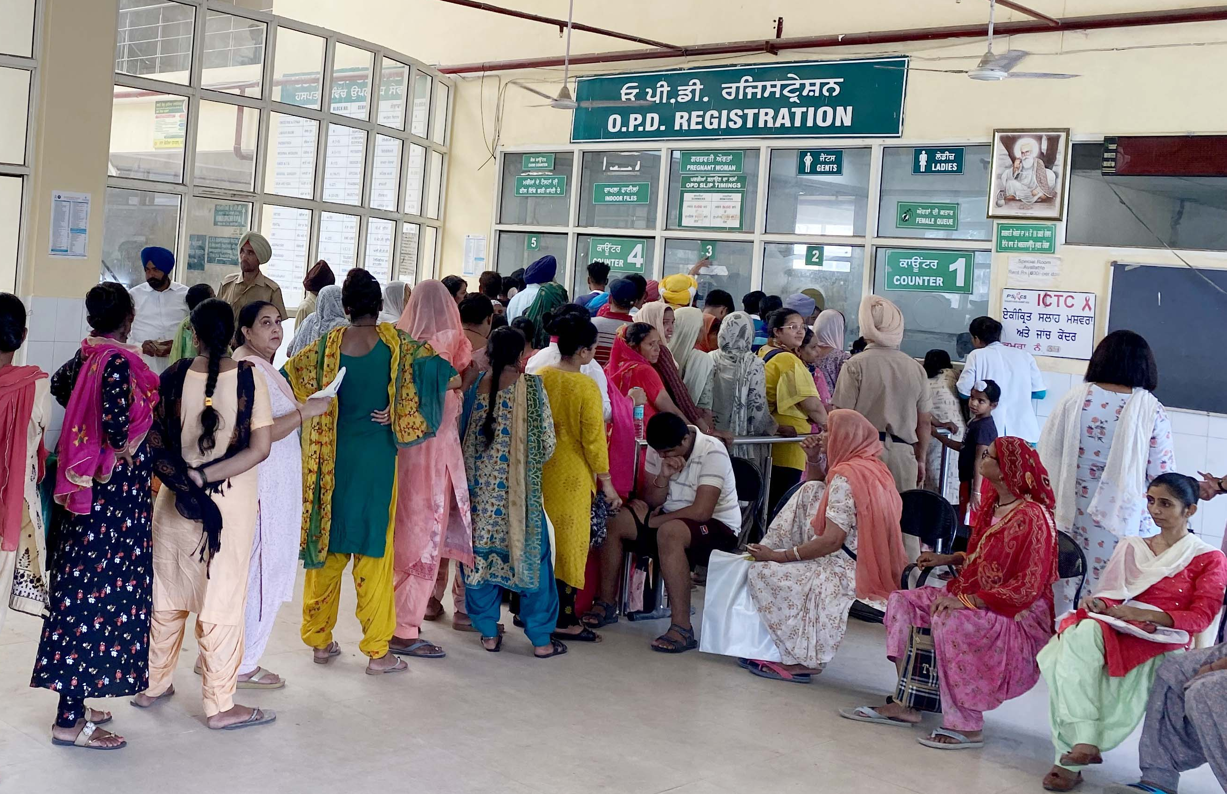
Medical Centers have complex security and operational needs. Medical Center premises serve hundreds and thousands of patients and their visitors every day.
To manage these visitors and patients at the reception area with the paper-based system is basically a very tedious and nonsecure task.

Slide 8
This system is one way to manage these visitors at the reception area with the advancement in technology reception management systems are enabling a contactless visitor check-in
experience, by replacing paper logbooks.
The system makes managing visitor’s check-ins easy and secure for Medical Centers.
The management system will use this system to store and process patients’ medical record. Upon a patient showing his medical id, they will provide a patient with his medical record.

Slide 9
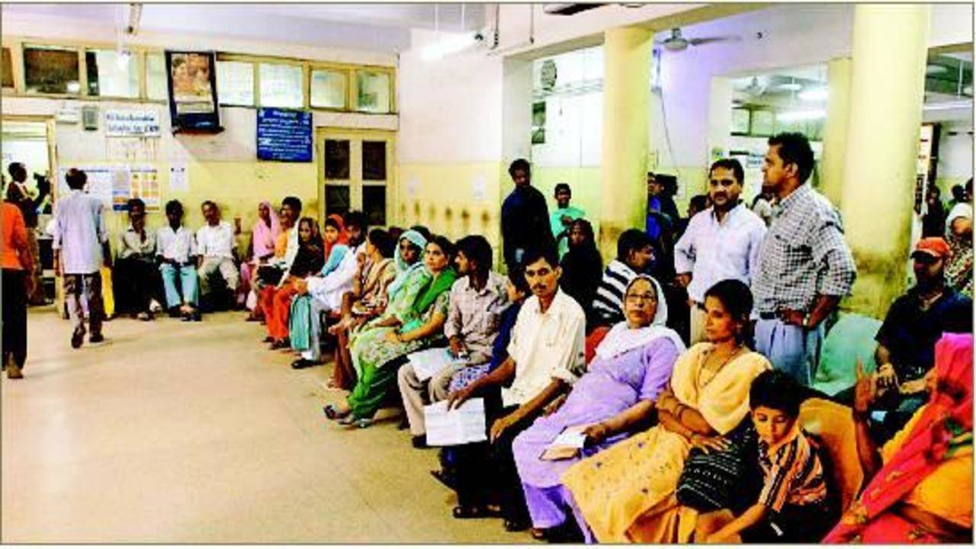
One of the main problems with traditional primary care is the struggle to get a timely appointment with your doctor.
You call your doctor hoping to get an appointment, but find out they are booked for days, if not weeks.
Or you have to wait long before your serial comes.

Slide 10
In this system, General users will be able to check the schedule of the doctor they want to meet at a given period and decide on a suitable slot of appointment.
If any doctor decides to not go for the appointments of the day, users will be notified of it and they will pick some other day to get an appointment.

Slide 11
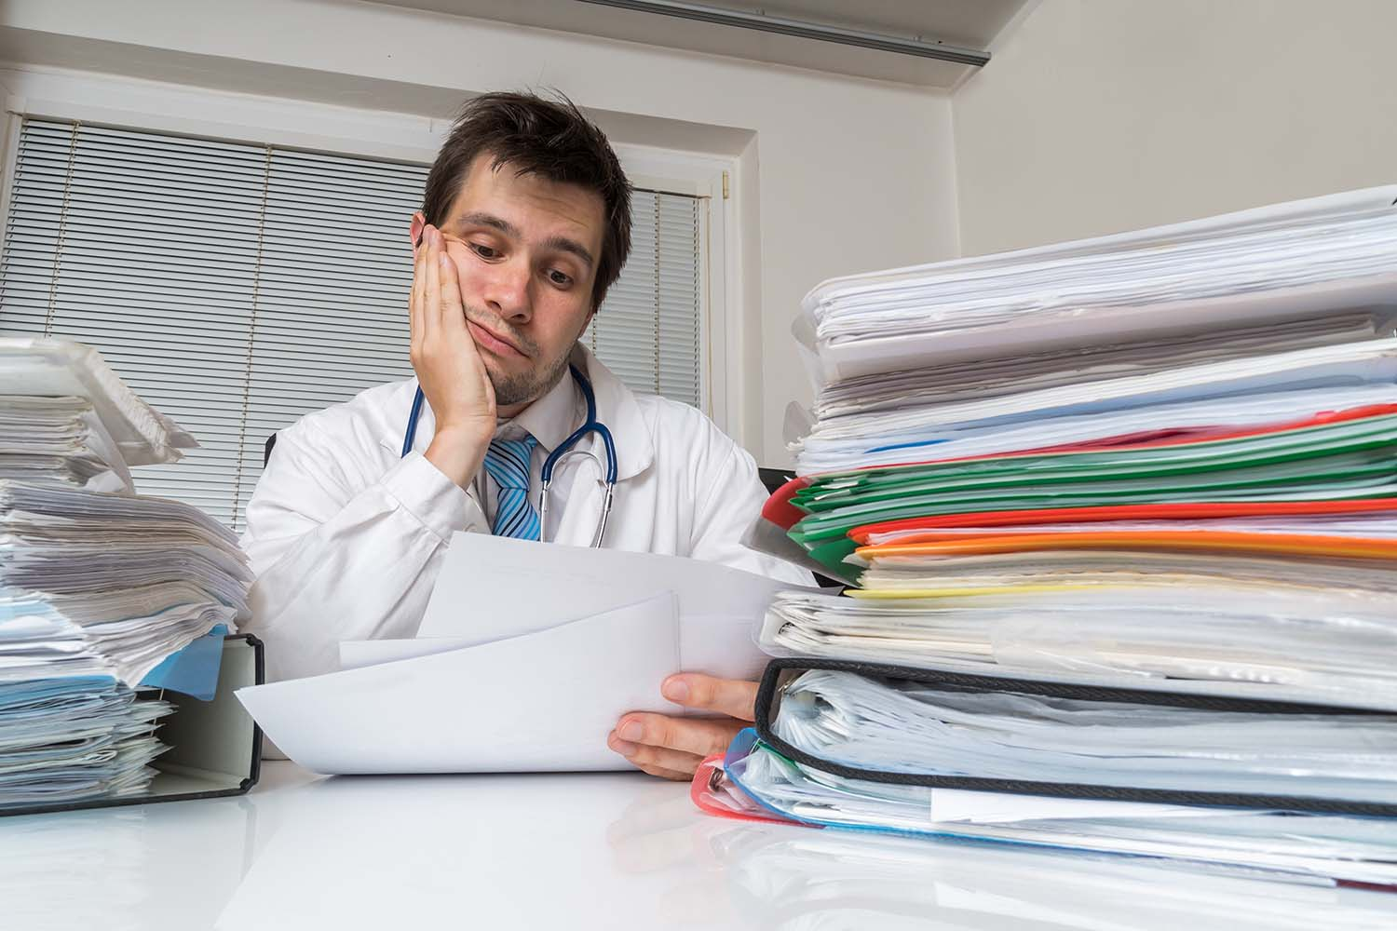
Eliciting a patient's past medical history is an essential clinical skill.
Patients often come to the visit unprepared; they are unsure about the symptoms they are experiencing and have trouble reporting symptom duration and intensity.
Sometimes patient can not provide their previous medical information or report card.
This is very much time consuming to maintain the medical record of the patient.

Slide 12
This system provides the digital EMR or EHR system which enables your doctors to quickly understand the patient’s current medical needs and provide appropriate care.
EHRs typically allow the patient access to their own medical data, which is nearly impossible with paper records.
They eliminate paper clutter, and since the practitioner notes are typed rather than handwritten, they’re less likely to be misunderstood. At this point, digital recordkeeping is the industry standard.

